Slide 1


Doing business in Russia
Teimuraz Vashakmadze

Slide 2
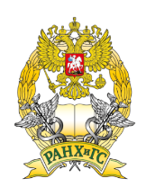
What is perception?
Legal protection, corruption and easiness of doing business are perceived by the global community as the largest barriers preventing business in Russia
Positive macroeconomic outlook is not always strong enough to overcome perceived barriers
But…
  Business travel tends to be positively correlated with a perception of a favorable business climate in the region
  Positive personal experience overshadowed by negative noise in the mass media
Source: KPMG. Global Perception of Moscow as an International Financial Center

Slide 3
Country snapshot
Population (2011): 143 mln.
Cities over 1 mln.: 14
Nominal GDP: ~1,6 trln. Euro
Real GDP growth (2012): +3,4%
Average real GDP growth (2000-2012): +5,2%
Inflation (2012): +6,6%
Average inflation (2000-2012): +11,8%
Foreign reserves (17.05.2013): $512,4 Bn.

Slide 4
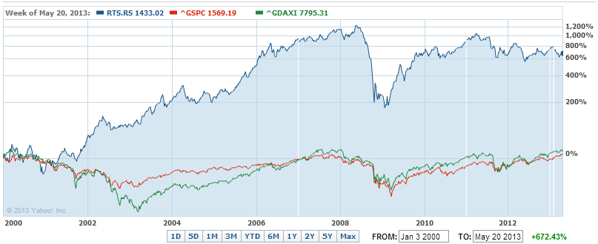
RTSI vs. S&P500 vs. DAX

Slide 5
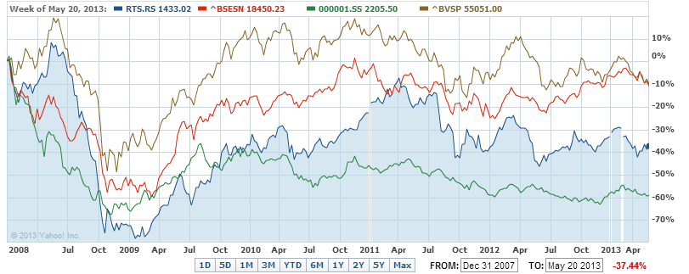
BRIC (2008-2013)

Slide 6
Has Russia experienced economic miracle?

Slide 7
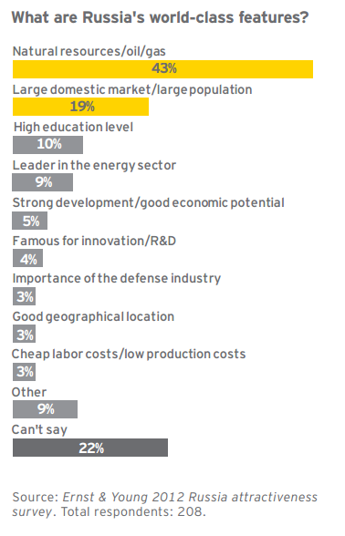
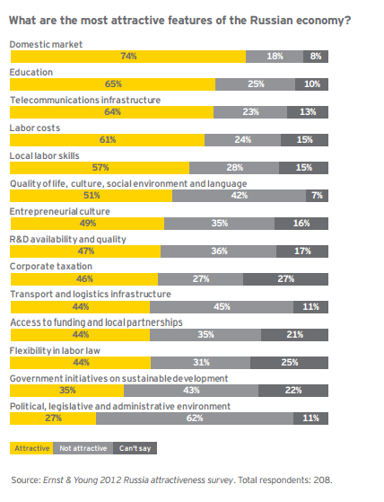
Natural resources is Russia’s most globally competitive feature

Slide 8
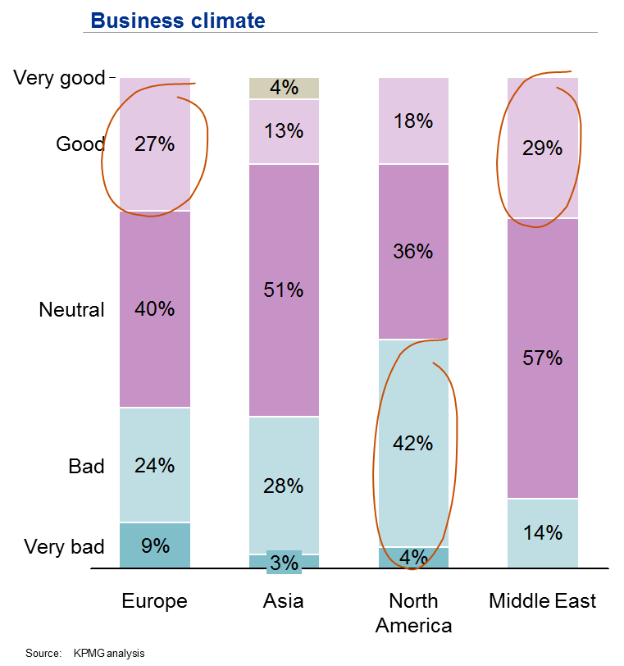
Europe and Middle East tends to be more neutral or optimistic impression of the business climate in Russia

Slide 9
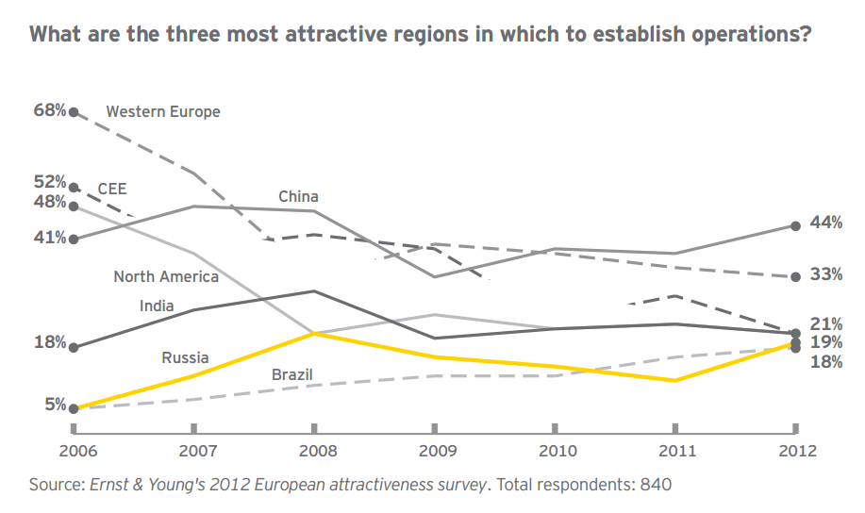
Russia has joined competition

Slide 10
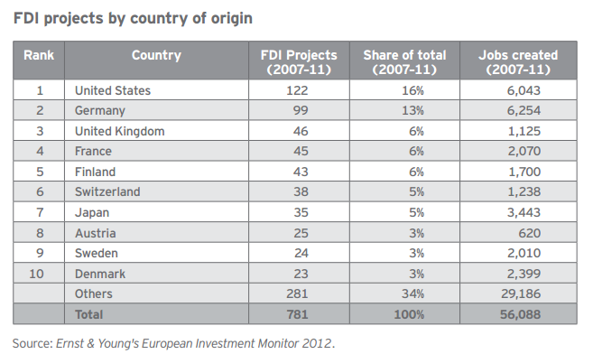
Europe continues to have the largest number of realized FDI projects in Russia

Slide 11
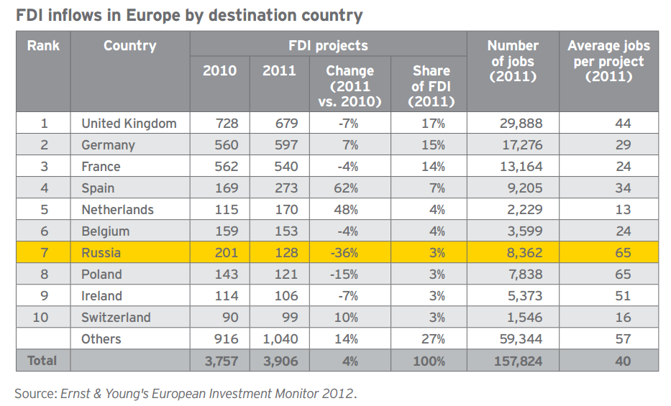
Russia is seventh-largest for projects

Slide 12
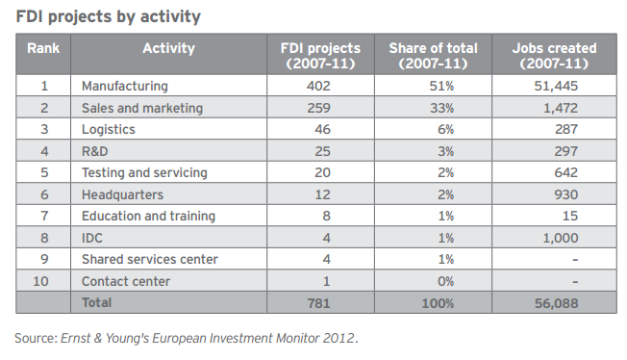
Investors come to Russia to manufacture goods for the local market, but also distribute globally

Slide 13
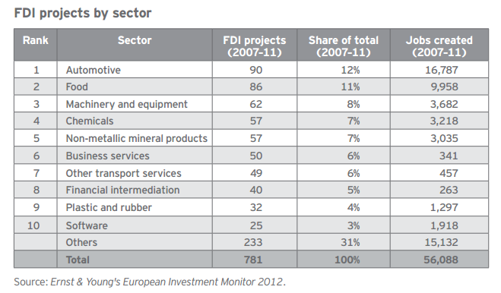
Russia’s industrial sector attracts more FDI projects than any other sector

Slide 14
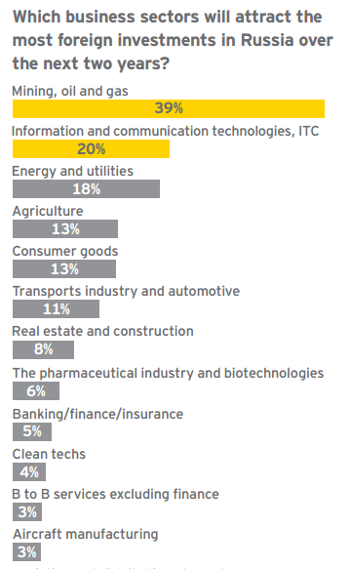
“In 2011, the number of Russians online went up by 14% to 53 million, making the country’s online population the largest in Europe”.
Source: Ernst & Young 2012 Russia attractiveness survey. Total respondents: 208.

Slide 15
Accounting environment
Every legal entity registered in Russia must prepare standalone RAS financial statements for each financial reporting (calendar) year ending 31 December.
The audit of annual RAS financial statements is mandatory for:
  Open joint stock companies
  Companies with securities traded on stock exchanges
  Banks and other lending agencies, insurance companies, credit bureaux, pension and investment funds, securities’ markets participants and stock exchanges
  Companies with annual revenue for the preceding financial year exceeding RUB 400 million (approximately EUR 10 million)
  Companies with total assets as at the preceding 31 December exceeding RUB 60 million (approximately EUR 1,5 million)

Slide 16
Taxation
A foreign legal entity which conducts activity in Russia through a representative offices, branches, construction sites and other places of business, for a period exceeding 30 days in a calendar year, is required to register with the Russian tax authorities within 30 days of commencing activity
Key tax rates:
  Profit tax: 20%
  VAT: 18%
  Property tax: 2,2%
  Social contributions: 30% (before 568 000 rub.), 10% (above 568 000 rub.)
  Personal income tax – 13% (for residents), 30% (for non-residents)
  Dividends – 9% (for residents), from 5% (under DTT)

Slide 17
Double tax treaty with the Netherlands
Dividends:
  Major shareholding – 5% (25% & EUR 75,000)
  Minor shareholding – 15%
Interest – 0%
Royalties – 0%

Slide 18
Currency control
Transaction passports. This involves filing documentation relating to the transaction with the bank.
Payments between residents can only be made in rubles (exception borrowing in foreign currency)
Residents are required to notify the local tax authorities on opening or closing an account in a bank located outside the RF.

