Slide 1


Ontology of socially responsible investing. Applying global frameworks for an emerging market in Russia
Teimuraz vashakmadze, phd
Associate professor, Ranepa
Executive director, rgg capital

Slide 2
Content
Business valuation
3
Stakeholder theory
4
Brief literature review
5
Environmental, Social, and Governance (ESG) Ratings as a Sustainability Proxy
6-7
SRI (socially responsible investing)
8-17
Case: Aviva Investors
18-19
The roots of the SRI
20
The model of the SRI forecast in Russia
21-22

Slide 3
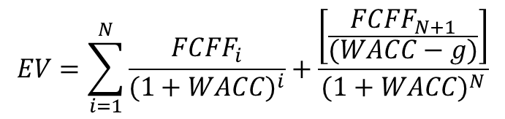

Business valuation
DCF model
$$EV=\sum_{i=1}^{N}{\frac{{FCFF}_{i}}{{(1+WACC)}^{i}}+\frac{\left[\frac{{FCFF}_{N+1}}{(WACC−g)}\right]}{{(1+WACC)}^{N}}}$$
Cash is king
$$FCFF=EBIT∗(1−T)+DA−∆WCR−CapEx$$
Going concern principle => investor needs to understand if company’s cash flows are sustainable in infinity
Business valuation is subjective => value for me ≠ value for you
$$f(DFE,IFE,EM)$$

Slide 4
Stakeholder theory
Stakeholders view – maximization of shareholders value is possible only if company’s performance maximizes value for all stakeholders
Value map
Value ↑
Financial metrics
Sales ↑
Opex ↓
WCR↓
Capex ↓
WACC ↓
Clients
Employee
Suppliers
Shareholders
Banks
Stakeholders
Government
Communities
Investors
Etc.
Sustainability of cash flows can be achieved only by reducing strategic risks through stakeholder management

Slide 5
Selected (brief) literature review
Patten (1990) found evidence that investors used social responsibility information in valuations.
Waddock and Graves (1997) established that superior social performance is indicative of good management practices consequently translated into better performance on the financial level, this link between social and financial performance was also concluded by (Orlitzky et al., 2003) and (Kurtz, 2005).
Doh (2010) found that investors are concerned about the social performance of firms in which they invest.
El Ghoul et al. (2011) found that firms with better corporate social responsibility scores obtain cheaper equity financing and have higher valuations.
Bird et al. (2007) or Guenster et al. (2011) found a positive relationship between social responsibility and market value.

Slide 6
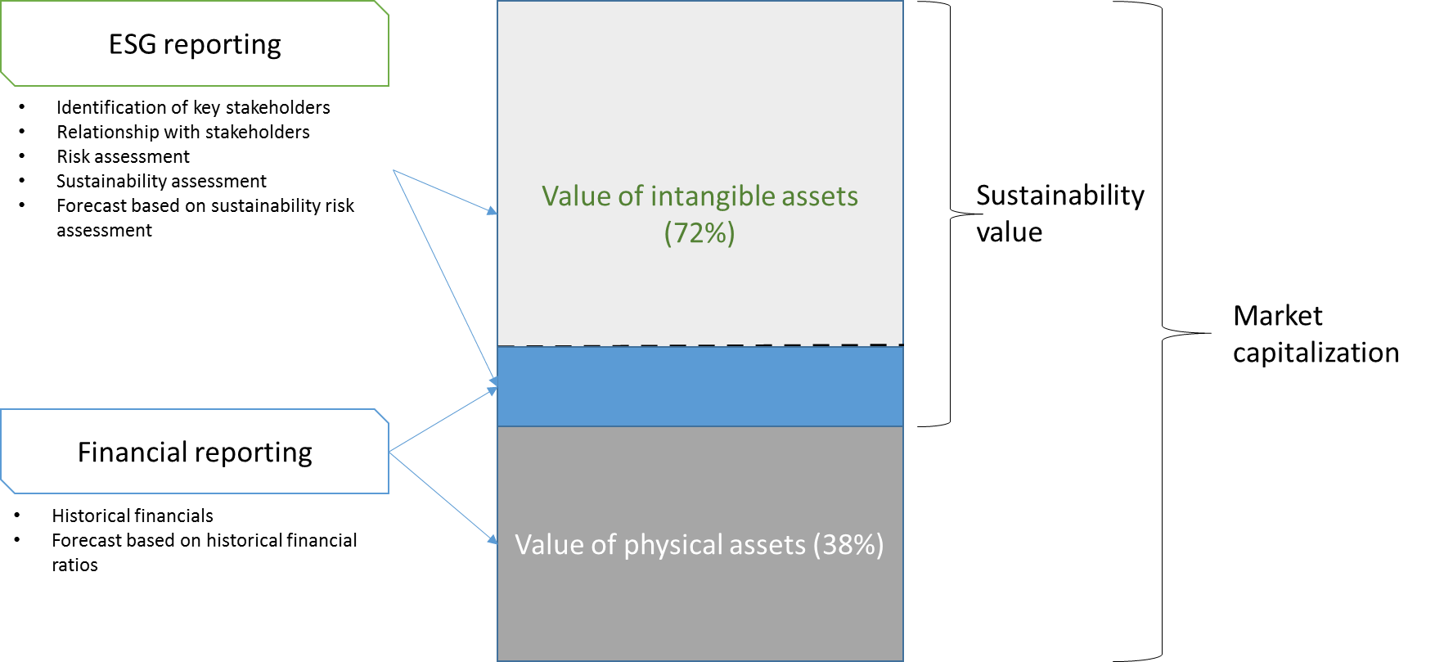
Environmental, Social, and Governance (ESG) Ratings as a Sustainability Proxy
ESG ratings may represent the best indicator of a corporation’s efforts towards sustainability.
In a proposed model a company’s market capitalization can be at least partially explained according to its sustainability risk: Higher (Lower) sustainability risk will be reflected in lower (higher) market-to-book ratios.

Slide 7
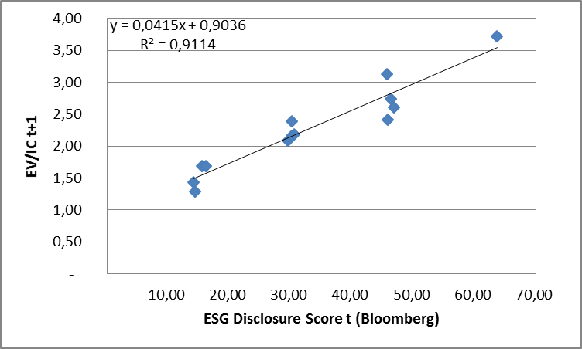
Environmental, Social, and Governance (ESG) Ratings as a Sustainability Proxy
Hypothesis to be tested: The level of disclosure of ESG factors contains information value about the corporation’s future market capitalization.
Findings:
The level of disclosure of ESG factors has a significant impact on future market capitalization of a company.
Investors are using ESG factors as an input parameter in valuation models for estimation of a fundamental value of a company.
The more ESG information disclosed by the company, the more that investors have transparency for sustainability-risk assessment.

Slide 8
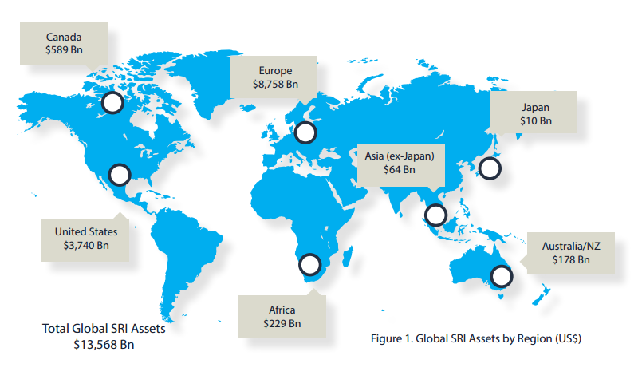
More than 13,6 trillion dollars are managed by the funds investing according to SRI principles, which is 21,8% from total assets under management by investment professionals.
* Global Sustainable Investment Review 2012

Slide 9
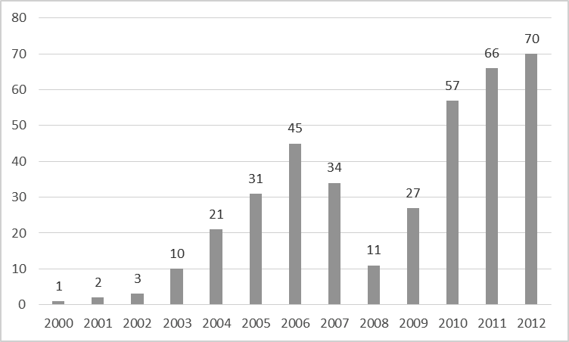
The number of companies, which publish non-financials reports annually.
* CALCULATIONS WERE MADE ON THE BASIS OF RSPP (THE RUSSIAN UNION OF INDUSTRIALISTS AND ENTREPRENEURS) DATA.

Slide 10
Why investors want to analyze information about ESG factors?
Nowadays only 37% of market capitalization is explained by the balance sheet, and 63% is the market value added, also known as, intellectual capital.
If we analyze analytical reports of respected investment banks, we will see that company valuation based on the DCF (discounted cash flow) method, that the terminal value is about 70% - 80%, and sometimes is close to 90% from the total value.
It is becoming important for investors to assess the long-term sustainability of a company, but this cannot be done without understanding what type of relationship the company has with its stakeholders.

Slide 11
SRI – is an investment process which takes into account not only financial indicators, but also the long-term social and ecological consequences from investments.
Seven distinct responsible investing strategies:
Sustainability themed investment (eSg, Esg)
Best-in-Class investment selection (positive screening)
Norms-based screening (negative screening, ethics)
Exclusion of holdings from investment universe (negative screening, ethics)
Integration of ESG factors in financials analysis (ESG cross sectional)
Engagement and voting on sustainable matters (esG)
Impact investing (social impact sub category, microfinance impact sub category)

Slide 12
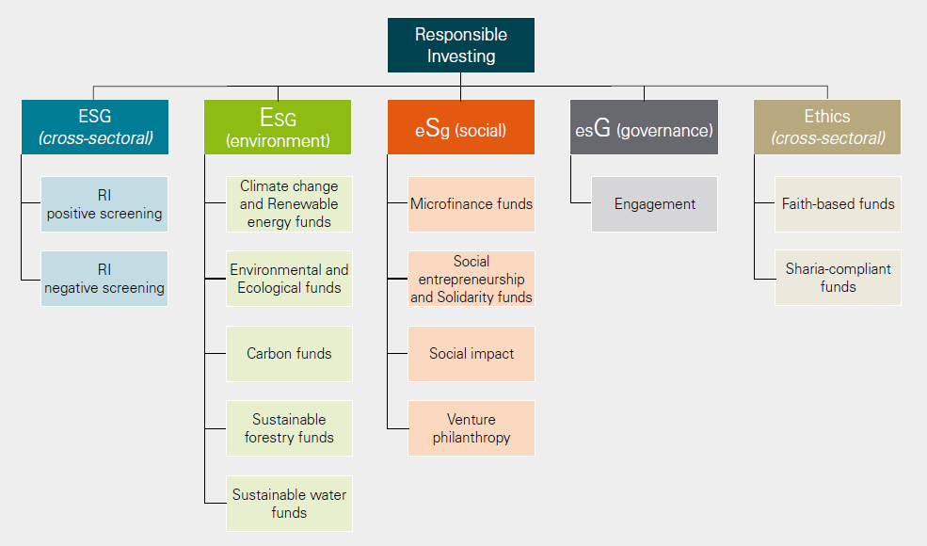
ALFI 2012

Slide 13
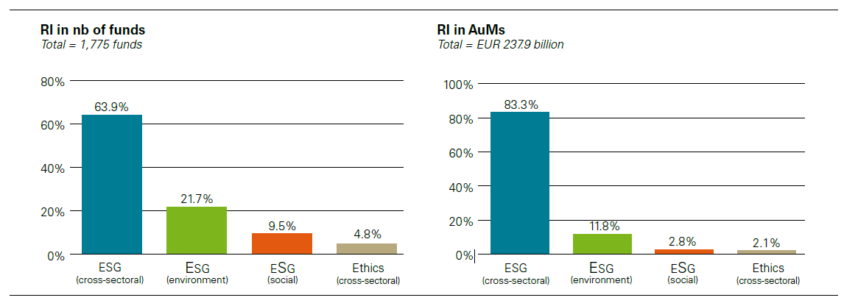
Responsible investing funds in Europe
European Responsible Investing Fund Survey, 2013

Slide 14
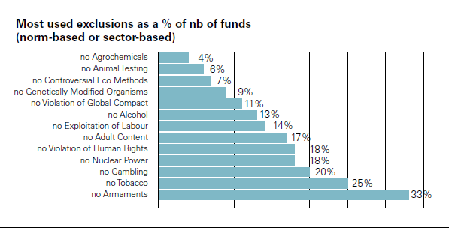
ESG (cross sectional)
European Responsible Investing Fund Survey, 2013

Slide 15
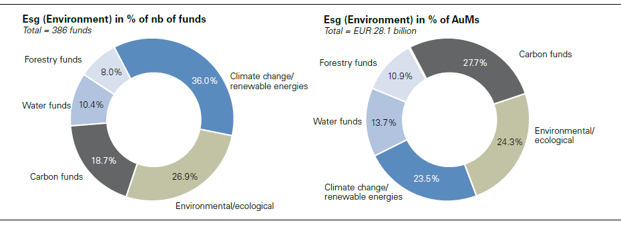
Environmental funds
European Responsible Investing Fund Survey, 2013

Slide 16
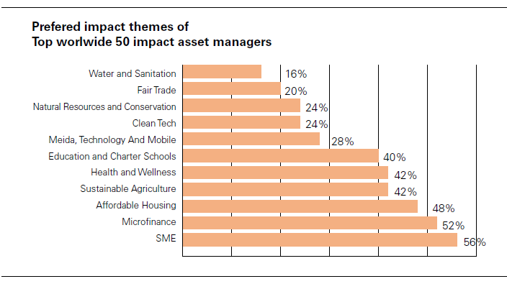
Impact funds
European Responsible Investing Fund Survey, 2013

Slide 17
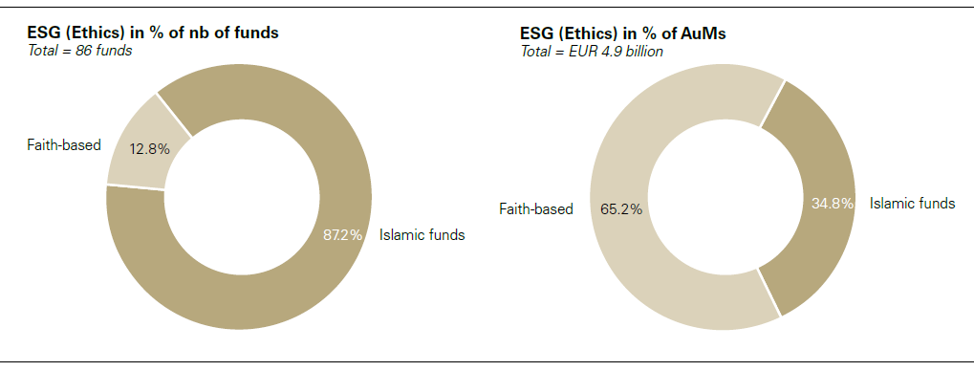
Ethics funds
European Responsible Investing Fund Survey, 2013

Slide 18
Case: Aviva Investors (1/2)
Investor: Aviva Investors (a part of the largest British insurance company Aviva) – AUM more than $400 bln.
Invested in company: Vedanta Resources (passive portfolio that mirrored the market).
Problem: From Aviva Investors' point of view, the Vendanta Resources company was undervalued by 29% compared to its peers, with the main reason of unethical company behavior in India (the company was accused of human rights and business ethics violation).
Strategy: Engagement and voting on sustainable matters (esG). Instead of positions close in Vedanta Resources, Aviva Investors prepared the situation analysis and offered some recommendations for the situation improvement.
Motivation: According to the Aviva Investors position, if they had chosen a different way by selling out Vedanta Resources shares and had not attained the improvement of its business practice, they would have undermined their authority in public's view.

Slide 19
Case: Aviva Investors (2/2)
What Aviva Investors proposed (action plan):
Expand the health, safety and the environment committee's authority, which should include all aspects of ESG
Train and assign responsibility at the level of the board of directors concerning the ESG risks.
Attach remuneration of the board of directors and top management to the ESG index
Organize mechanism of complaint examination on all company's operations
Improve the risk management system
Stick to the OECD and UN standards of responsible business running
Strengthening of the ESG policy maintenance control system

Slide 20
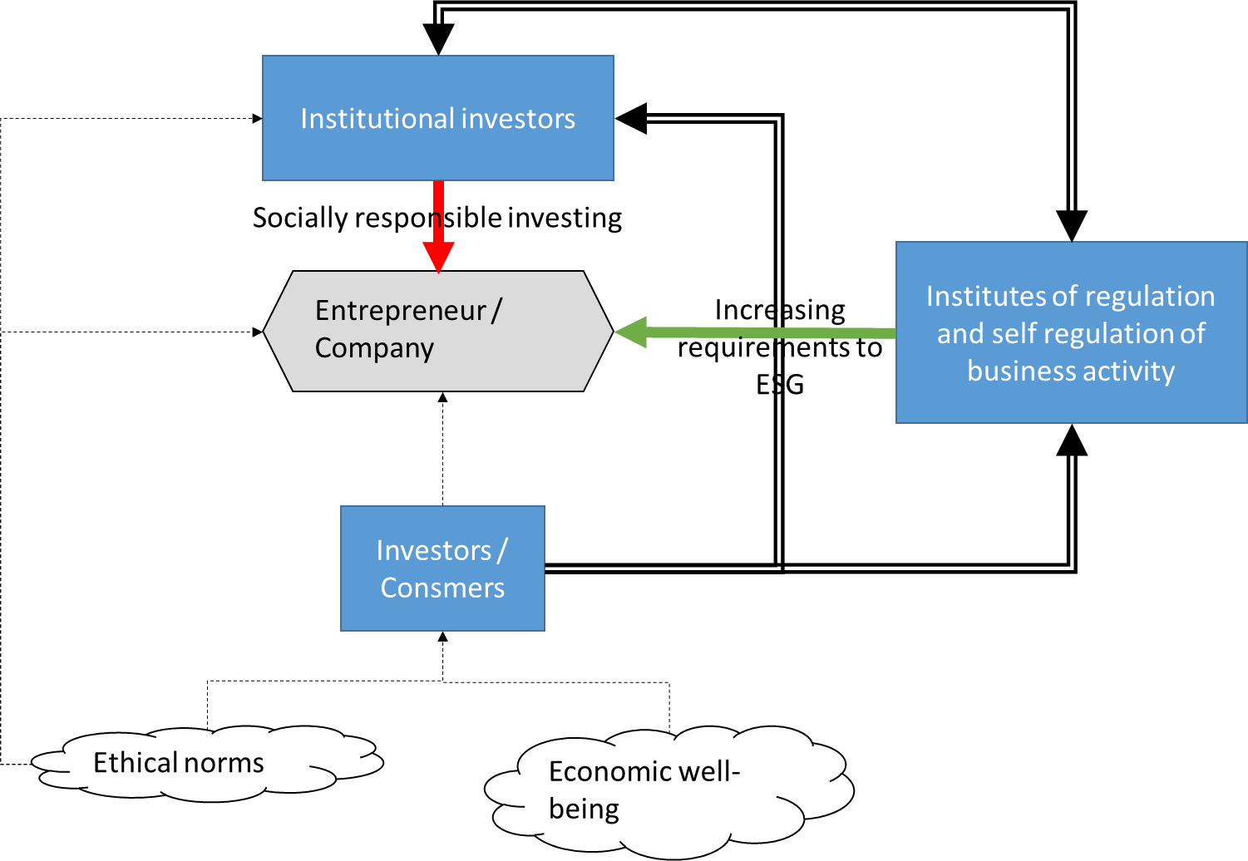
Ethical norms are the basis for all agents, but they are not pushing SRI, while society will not achieve economic well-being, which will allow society to become an active participant of investment process.

Slide 21
Transformation of business practices is possible under the pressure of two factors
Existence of systematic ethical requirements and expectations from business, which are arranged in clear linguistic and behavioral standards supported by external stakeholders
Stakeholders’ ability to influence business (to increase costs or yields) depending on the compliance or non-compliance of entrepreneurs and top-management of corporations to the standards reflecting stakeholders' expectations

Slide 22
This theoretical framework (model) enables us to identify the gap between Russia and those countries with higher level of socially responsible investment development.
Stakeholder’s type | Ethical requirements (A) | Stakeholders’ ability to influence business (B) | Points = A*B
Consumers, clients | 0 points | 2 points | 0
Investors (individuals) in mutual funds, pension funds and other investment funds | 1 point | 1 point | 1
Institutional investors | 1 point | 1 point | 1
State and regulative institutions | 1 point | 2 points | 2
 |  |  | 4 out of 16

